Slide 1
Weekly updates - 09/13/2021 - AI Institute
Plan for this week
Continue Refining data dictionary
Continue Refining database
Plan for material planner interview
Continue working with Fraunhofer team for database
Work on Deliverable #1 to BMW
Progress made last week
Drafting Data dictionary
Preparing preliminary database design

Slide 2

0 %
100 %
Material Planner (Table 1)
Supplier (Table 2)
Health
Status
Recommendations (Table 6)
Material
Planner
has
1..*
Supplier
(Vendor)
recommend
Responsible
supply
use
Output
1..*
Material
Planning
has
Material
(Part)
input
Material Inventory
input
Material Trans. (Table 4)
use
Material Config. (Table 3)
generate
Exception
Exception (Table 5)

Slide 3

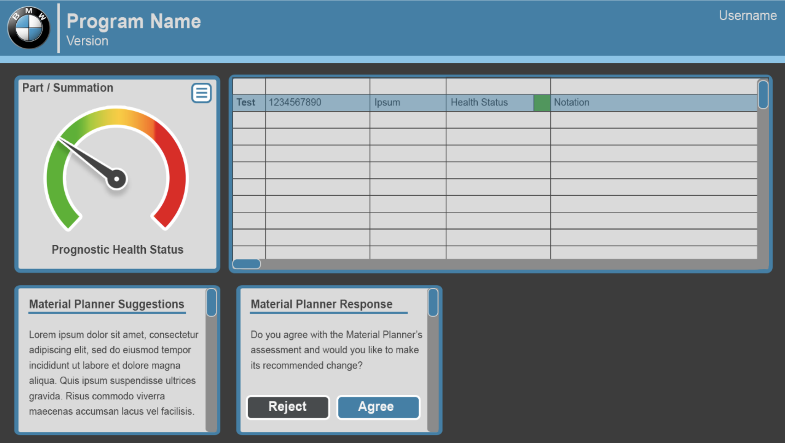





Conceptual design
Parts DB
Fetch and Retrieve Part Info
Dashboard
A
B
H
Get Recommendation
Fetch Part Info
Material Planner (Table 1)
E
Make Recommendation
C
D
G
Supplier (Table 2)
Material Config. (Table 3)
Run Forecast Model
Fetch Forecast Model
Parts
Forecast
Model
I
J
F
Fetch Rulesets
Recommendation
Decision & Reason
Material Trans. (Table 4)
AI Material Planner Assistant
Recommendations (Table 6)
Exception (Table 5)
Rule sets and Business logic

Slide 4
Data Dictionary for Material Planner
Objectives
Identify most important columns for Material Planner
Identify columns that can be imported from Parts DB
Identify columns that can be generated by Reco. Engine and Forecast Model
Data Dictionary Schema
Example
Column | Possible Value
Name
Type | Text/Number/Date
Description
Source | Material Planner (or Part DB)/Algorithm
Frequency of change | High/Low/None
Purpose | Forecast Model, Reco. Dashboard, What..if
Column | Possible Value
SafetyStck
Type | Number
Description | …
Source | Material Planner (or Part DB)
Frequency of change | Low
Purpose | Forecast Model, Reco. Dashboard, What..if

Slide 5
Material Planner (Table 1)
MRPCn (PK)
Vendor ID
Supplier (Table 2)
Vendor ID (PK)
Vendor Name
Material ID
Recommendation (Table 6)
Material ID
Health Status
Material Config (Table 3)
Material ID (PK)
Material Desc
Safety Stock
Planning Time Fence
Safety Time
Planning Calendar
Material Transaction (Table 4)
Material ID
Material Trans. Date
Stock DoS
First Receipt DoS
Exception ID
MRP Element
Available Qty
Exception (Table 5)
Exception ID (PK)
Exception Message

Slide 6
Detail
Data Dictionary

Slide 7
# | Action | Description
A | Fetch Part Info | Planning Assistant queries Parts Data Source for all part information.
B | Retrieve Part info | Planning Assistant Stores part information as a local data set.
C | Run Forecast Model | Planning Assistant feeds Part information to the forecast model.
D | Fetch Forecast Model | Recommendation engine retrieves current Forecast model variables.
E | Fetch Part Info | Recommendation engine retrieves part information.
F | Fetch Rulesets | Retrieve Rules and business logic from Rulesets DB
G | Make Recommendation | Recommendation engine generates recommendation.
H | Get Recommendation | Recommendation, Decision, and Reason is returned from Assistant.
I, J | Update Reco. DB | The database will be updated with the predictions from Forecast Model and recommendations from recommendation engine

